Slide 1
Get Off to a good start – for the instructor
Dear instructor
At your fingertips is a presentation that you can use as a starting point for facilitation based on the EASI typology. All you have to do is select the slides you wish to use and delete or hide the rest.
Remember to use the team’s own profiles when you show team analyses. Insert them in place of our examples.
The presentation is structured as follows: Introduction, topics and closing. Before you start, please select one or more topics and delete the rest. Under each topic you will find a number of exercises to choose from. For easy navigation, each topic starts with a green cover page and exercises start with a blue page.
Materials for the exercises can be printed from the collection ”EASI – Floor exercises for print”.
Enjoy!
The Master Denmark team
Notes:
Introduction for the instructor. To be deleted from the final presentation.

Slide 2
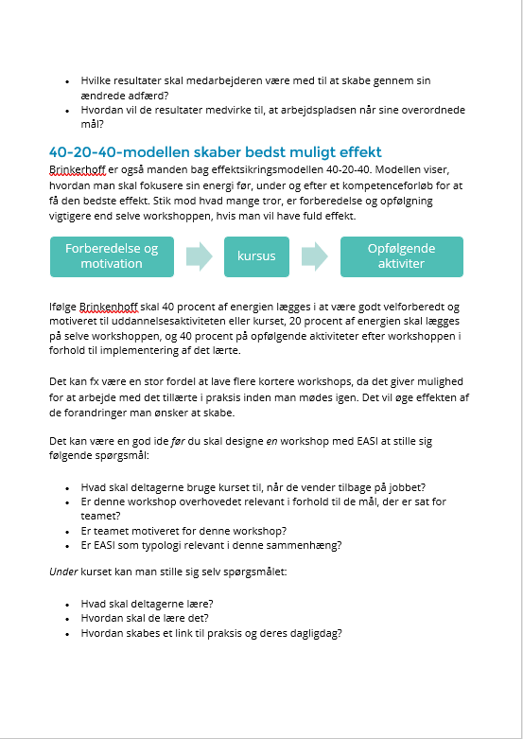
Useful documents – for the instructor
Read the document ”Plan a successful EASI workshop” before you start to adjust this presentation. You will also need the collection ”EASI – Floor exercises for print” in connection with several exercises in this presentation.
Get the materials here: https://master.dk/loesninger/easi/easi-materiale/
Notes:
Introduction for the instructor. To be deleted from the final presentation.

Slide 3
Get Off to a good start – for the instructor
Introduction
Agenda
Situation
Topics
Select one or more relevant topics
Select the exercises you want to use for the topic
Closing
Recap and evaluation
For next time
Purpose
Select an introduction exercise
Hand out reports
Notes:
Introduction for the instructor. To be deleted from the final presentation.
Pay attention to where you need to choose among the topics and exercises. Delete the slides, you don’t need from the presentation.

Slide 4
Topics to choose from
What is EASI? (should always be included)
Team
Cooperation
Strengths & Pitfalls
Motivation
Spot a type
Communication
Leadership style in the team
Prevent conflicts in the team
Introduction
Agenda
Situation
Topics
Select one or more relevant topics
Select the exercises you want to use for the topic
Closing
Recap and evaluation
For next time
Purpose
Select an introduction exercise
Hand out reports
Notes:
Introduction for the instructor. To be deleted from the final presentation.
Overview of the topics in this presentation. Select the topic or topics that are relevant to your current situation. The topics start with a green slide that is only for you. The exercises that go with the topic start with a blue slide that is also just for you.

Slide 5
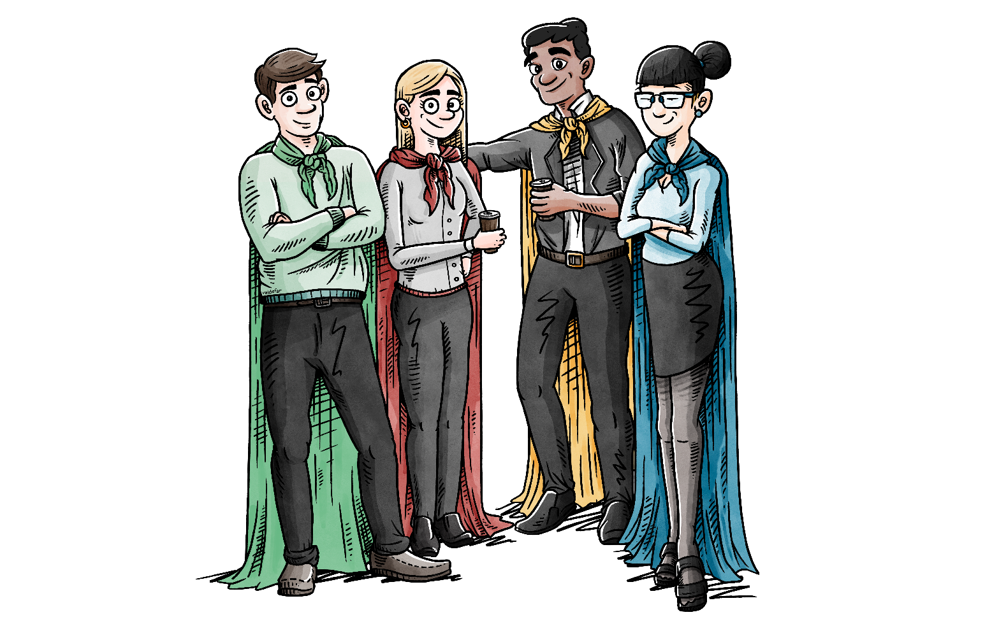
[your heading for the day]
Notes:
Cover page for your presentation. Insert your own heading for the day.

Slide 6
introduction
Select and adjust the relevant slides
Delete the other slides
Delete these instructions

Slide 7
agenda
Topic for today
What is your current situation?
What is the purpose of today?
Introductions
Our process
Team definitions
The EASI typology?
Exercises
Recap and evaluation
Notes:
Example agenda. Adapt it to your situation and your selection of topics.
Add your own points to describe your agenda and to show a red thread through your event.

Slide 8
Current situation
What do we hope to get out of our time together?
We want to become experts on developing and project managing across entities
We want to cooperate on digitalisation and maintenance of digital processes.
We want to get to know each other better because it creates a strong foundation for cooperation and job satisfaction.
Notes:
Example description of the situation. Adapt the text.
Make answers to describe your situation and why you are gathered today.

Slide 9
purpose
Our purpose is to strengthen cooperation and communication within our team by using the EASI typology, including:
Becoming aware of the types represented in our team and among our colleagues
Create a common language
Respect and accept our differences
Focus on how our team’s strengths can best be utilized
Make agreements about how we want to cooperate in the future considering our team’s organization and types.
Notes:
Example description of your purpose. Adapt the text.
In addition to your current situation, what is the purpose/cause/aim of your workshop?

Slide 10
exercises - Introduction
Select and adjust the relevant slides
Delete the other slides
Delete these instructions

Slide 11
introduction
My name
My role
My expectations for today
My team is good at…
My team has the potential to be better at …
Notes:
Recommended introduction to your workshop, if participants already know each other (more or less).
Do it in plenary, eg. around the table.

Slide 12
introduction
Interview the person next to you for 4 minutes:
What are your primary tasks in your job?
What are your expectations of today?
What characterizes your team – strengths and challenges?
Introduce your partner to the rest of the group in less than 2 minutes.
Notes:
Alternative presentation format, like ”speed dating”, if participants don’t know each other, or if you have a large group in your workshop.
After brief preparation, participants introduce each other – in plenary, around the table.

Slide 13
introduction – who am I?
Select a card/image that best illustrates who you are.
You decide what you would like to share.
Max. 10 minutes to select and prepare.
Max. 5 minutes to tell your story to the group.
Notes:
See description of the exercise on the next slide.
Time can be adjusted as needed.

Slide 14
Description of the exercise ”Who am I?”
Purpose: That participants have an opportunity to share something about themselves in an unusual and fun way. The exercise can be reused several times during a session if you change the question to be answered.
Materials: You will need a number of cards/images (40 or more, different ones). Master uses cards from Dialoogle.dk, but you can also just find 40 images yourself. Master has an agreement with Dialoogle that allows Master’s clients to get a discount. Contact Master Denmark for a discount code.
Bring the images and the slide. Some participants will want to select more than one image. Decide in advance whether that is ok.
Exercise: Spread the cards on a table/floor of your room. “Select a card that you think describes you/your team the best. Select the card that best describes your work situation right now!”
Observations: Notice that some participants need more time to select and prepare themselves than other. Notice how the other participants react to the stories told. Notice that some are less comfortable with telling their story than others. You might want to make some notes during this exercise.
Reflections: If there is trust and openness in the group, this exercise may be altered so that participants select images for each other and share the reason for their choice. Is there a connection between how the participant reacted to the exercise and that person’s typology? Is there a connection between the image, the participant selected and that person’s typology? You might let the selected images keep hanging in the room.
Notes:
This description is for the instructor and should be deleted from the final presentation.

Slide 15
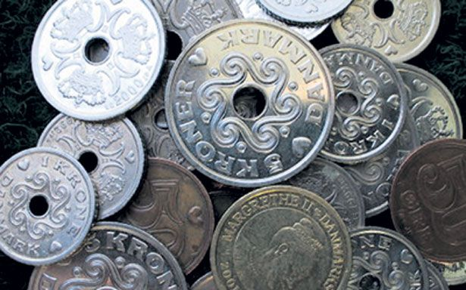
introduction – your year
Draw a coin or a piece of paper with a year written on it.
Find a partner.
Tell your partner where you were andwhat was going on in your life in that year. You decide what you would like to share.
Max. 2 minutes each.
Then switch years with your partner.
Find a new partner – start over.
1985, 2003, 1962 , 1976…
Notes:
See description of the exercise on the next slide.
This exercise takes approx. 10 minutes

Slide 16
Description of the exercise ”your year”
Purpose: To give participants a fun and unusual way to introduce themselves to each other.
Materials: You will need a set of coins or small notes with a year written on them. Take care that the years have a reasonable distribution relative to the participants’ ages. A bag or box for the coins/notes.
Exercise: Participants draw a year from your bag/box, then find a partner.
Observations: Make sure that participants keep time. Call out “time to change” or similar at intervals, to make sure everyone has a chance to talk with as many other participants as possible within the time frame you have set. If there is an uneven number of participants the instructor participates, too. In case a year doesn’t work (participant is too young) the participant is asked to choose a year to talk about.
Reflections: Notice the mood in the room. Notice whether the participants seek out people they already know to partner with. Notice how the group approaches the task. Is there a connection between the group’s behaviour and their types?
Notes:
This description is for the instructor and should be deleted from the final presentation.

Slide 17
Topic – what is Easi?
Select and adjust the relevant slides
Delete the other slides
Delete these instructions
Notes:
This topic should always be included. It briefly describes the EASI typology to participants.

Slide 18
What is EASI?
A tool for development
Measures behavior and motivation
Does not measure knowledge, skills nor abilities
There is no right/wrong
Everyone uses elements of all 4 types
No type is better than another
Notes:
EASI is a typology that divides people into 4 basic types: Enthusiast – Supporter – Implementer – Analyst. The 4 types each have a preferred behavioral style and is motivated by different things.
Each type’s behavior has advantages and disadvantages.
EASI is used to test a person’s preferences and form hypotheses and analyses of individual’s/team’s primary focus areas.
EASI is typically used when assembling a new team, recruiting for teams, or for communication, efficiency and cooperation in existing teams.
For example, it may be used to analyze a team in conflict, where communication and efficiency in the team is marked by disagreements. It can also be used as a way to analyze and specify experiences from a well-functioning team that can be used later when assembling future teams.

Slide 19
What can EASI do?
Provide a common language and a shared understanding of how each person in the team sees themselves and the other team members.
Show how you work together, react, tackle tasks and how you prefer to think, act and feel.
Achieve openness about each other as types and thereby an increased understanding of your differences and similarities.
Notes:
Briefly share with the team why you have chosen to use EASI.
For example, it provides:
Insight into each other’s types and preferences
An understanding of differences and similarities
A common language and targeted communication
Improved cooperation

Slide 20
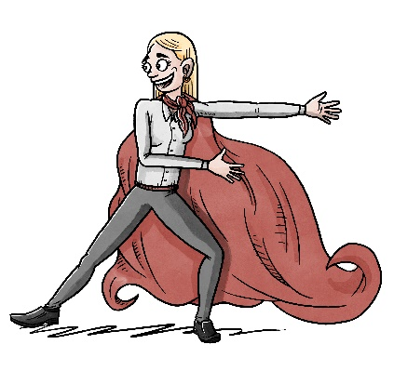
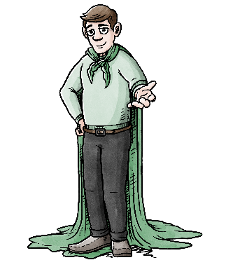
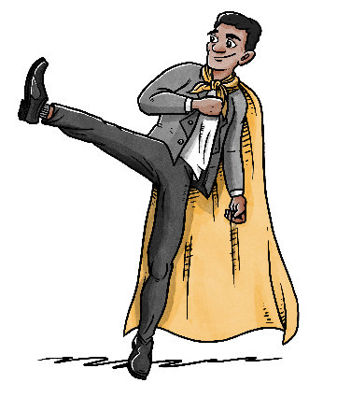
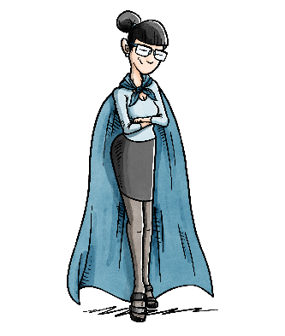
Four types
EASI has four types: Enthusiast – Supporter – Implementer – Analyst. The four types are very different from each other and all of them can be described through:
Characteristics
Strengths/pitfalls
Motivation
Communication focus and thinking style
Focus in cooperation
Notes:
Communication and motivation are essential to good cooperation. Knowledge, competences and personality have a strong influence on how we perform in our daily work but without motivation and communication adapted to our colleagues and customers, we will not get far.
EASI is a tool for development that tunes in on people’s
characteristics, strengths and pitfalls
motivation and how it affects communication, learning and development.
cooperation and understanding of others

Slide 21
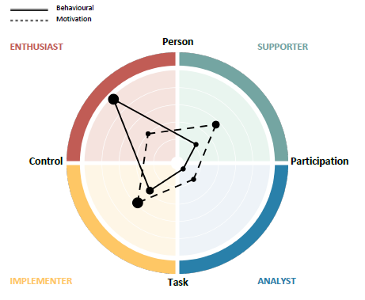
an Easi profile – example
Notes:
The EASI profile above shows a person’s behavior and motivation graphs as they fall within the 4 types, with a primary, secondary and tertiary placement. The central point is the 2 axes, Task-Person and Participate-Control. The behavior graph is shown with lines whereas the motivation graph is a dotted line.
It is in the gap between the two graphs, behavior/motivaiton, that you notice the differences between what the person does and what he/she is actually motivated for.
In this profile you see that the person’s behavior is primarily Enthusiast, with secondary behavior being Implementer. However, you also see that the person’s motivation is primarily Implementer with some properties from Supporter.
You might reflect on reasons why
the person indicates such a strong preference for Enthusiast behavior?
the person shows far more Enthusiast behavior than he/she is motivated for?
the person indicates less Supporter behavior than he/she is motivated for?

Slide 22
Characteristics
of the types
Person
E
Exuberant
Emotional
Outgoing
Influential
Like to experiment
Spontaneous
Sensitive
Empathetic
Welcoming
Harmony-seeking
Patient
Seeking cohesion
S
Control
Participate
I
Controlling
Result-orientated
Effective in decision-making
Pragmatic
Direct
Impatient
Deliberate
Systematic
Conscientious
Rational
Critical
Formal
A
Task
Notes:
These are characteristics that EASI measures directly.
Enthusiast
Characterized by openly showing feelings and engagement, using his/her intuition and senses while seeking influence, being dominant, visible, self-confident and wanting to make a mark on things.
The person who ”sets things moving” and is not afraid to take chances or run a risk in order to show new paths that can be taken.
Supporter
If we take the thing about feelings, sensing, intuitive and opennes and combine it with restrained, hesitant, listening and cooperating we meet the Supporter. The person who operates behind the scenes and makes sure everyone is ok. We call him Supporter because - as the name indicates - he is perfect at backing others up and ensuring everyone’s well-being.
Implementer
Characterized by a focus on goals and results combined with self-serving, visible, influential and self-confident we find the Implementer. She is driven by results achieved in the most effective way and is happy to make decisions on her own and independently of other people’s opinions.
She may be described as cool, controlling, headstrong, decisive and rather stubborn.
She is direct and often a person who will speak her mind freely.
Analyst
Characterized by being rational, professional, analytical, controlled and sometimes rigid, combined with being restrained, reluctant, listening and cooperative. He goes into depth with a task, goes into details and works carefully and thoroughly to ensure that all options have been considered and tested. He enjoys working with theories and considering alle possible alternatives before finally taking action. In case someone or something tries to prevent him from considering all aspects he will appear stubborn and strongly resist change. An analyst’s energy is connected to theories, methods and security.

Slide 23
Drawings of the types
Person
Enthusiast
Supporter
Control
Participate
Implementer
Analyst
Task
Notes:
The four types represented by drawings

Slide 24
Drivers of the types
Person
E
S
Development
Relationships
Control
Participate
I
A
Results
Quality
Task
Notes:
The primary driving forces of the four types

Slide 25
Extended description
Person
S
E
Motivated/engaged/fun
See opportunities/alternatives
Don’t follow rules
Want recognition
Talk a lot about themselves
Have many ideas
Love conceptual discussions
Animated, colorful and imaginative
Friendly and welcoming
Focus on relationships
Team players
Informal, empathetic and understanding
Involving and present in the moment
Seek consensus and compromise
Have a ‘feel’ for the organization
Listen – hesitate to express their opinion
Control
Participate
Impatient/speak clearly and directly
Take action
Take on battles
Focus on moving things forward
Want to decide
Focus on efficient meetings
Straight and to-the-point Controlled, authoritative
Calm and formal
Consistent and analyze risks
Make sound decisions
Focus on avoiding mistakes
Quality
Order and structure
Contemplation
Preparation
A
I
Task
Notes:
A few more words to describe the types

Slide 26
A Meeting with the types
Person
S
E
Often arrive late
Show up unprepared
Pretend to be prepared
Manage to jump in at page 2 section 3 and quickly form an opinon
Get ideas quickly
Are often inspired to take the meeting in an unexpected direction
Enjoy making quick decisions
Punctual
Strive to involve everyone
Prefer personal and professional recognition
Rarely push through their own opinions
Don’t share their views in a meeting if trust isn’t in place
Avoid being pressured into a quick decision
Control
Participate
Show up right on time
Enjoy taking the lead
Expect an agenda
Want efficient meetings without unnecessary sidetracks into other topics
Might get up and leave the meeting if they don’t consider the topic relevant
Avoid small talk
Arrive on time and preferably early
Are well-prepared – into minute details
Rarely speak out of order.
Might be irritated if others do, but will not show it.
Only interested in professional recognition. No need for personal recognition.
Avoid making promises they might not be able to keep
A
I
Task
Notes:
This model provides inspiration for how you might experience the four types, for example in a meeting

Slide 27
Onboarding a new colleague
Person
E
Short intro/informal
Get started quickly/flexible arrangements
Get to know decision makers
Key figures
Network
Lunch with CEO
Fast plan
Opportunities to ask questions along the way, as the need arises
Many meetings
Preferably 1:1
Time to meet colleagues (build relationships)
Ask how they are experiencing their onboarding? → care
Intro to the company’s values/code of conduct
CSR
S
Control
Participate
Quick overview
Want clear understanding of manager’s expectations
Well-defined KPIs
Start on own tasks as soon as possible
The organization and set up to be ready when they start
Focus on tasks and purpose
Avoid wasting time
Thorough systems training
Detailed intro plan
Time for immersion
Preferably online help
Annual accounts
Organization chart
Walk through job description
Full access to information
Written plan
I
A
Task
Notes:
This model provides inspiration for how you might recognize the different type’s preferences when onboarding a new colleague into a new job.
EASI can help you predict the type’s preferences and more quickly find a positive way to cooperate.
Most companies are good at telling you what they can do and want to do.
A new colleague will be expected to adapt to the company.
Everything is about the company.
But shouldn’t we be more focused on the new employee when it comes to onboarding?
As an employer this is an opportunity to tell the new employee how the company will adapt to that person!?! (Steve Jobs’ way of thinking)

Slide 28
exercises – what is easi?
Select and adjust the relevant slides
Delete the other slides
Delete these instructions

Slide 29
Get to know easi
Time to stand up ☺
Notes:
See description of the exercise on the next slide.
For participants who have no prior knowledge of the EASI model.
The exercise works best with max. 20 participants and takes approx. 30-45 minutes.

Slide 30
Description of the exercise ” Get to know easi”
Purpose: To increase participants’ understanding of the structure of EASI and their own place in the model.
Materials: Everyone must fill in the EASI profile in advance. Master’s EASI rug or masking tape and rope (min. 2 pieces each 4 meters). Printed materials from the collection “EASI floor exercises for print”.
Exercise: Everyone stands on the floor. Put Master’s EASI rug on the floor. Explain that people on the left side of the line usually prefer to take charge (Control) while people on the other side – right – usually prefer to go along (Participate) and observe what happens. Place the words (control/participate) on the left and right sides of the core model. Move yourself around to stand on the side that you are currently talking about.
Ask participants – one by one – to stand on the left or right side of the axis to show where he/she primarily sees him/herself during their work day. Point out that he/she can stand close to or far away from the middle line depending on how much he/she focuses on either controlling or participating. You might ask them to explain their choice. All participants should select a place to stand. We all have something in us that belongs on the opposite side of the line, but it is important to identify what each person mostly prefers.
If participants know each other well and you have enough time – you can ask the other participants if they think the focus person has chosen the right place and ask them to give examples to support their opinion in terms of behavior they have seen from the focus person.
Continues on the next slide….
Notes:
This description is for the instructor and should be deleted from the final presentation.

Slide 31
Description of the exercise ” Get to know easi”
continued…
Make a new vertical line relative to the first one, so they form a cross. Explain that people at the bottom of the axis usually focus on Tasks (what needs to be done) while people at the top of the axis primarily focus on People (who will do it). Place the words (Tasks/People) at the bottom and top of the core model
Place the EASI keywords for each type in each quadrant, 24 keywords in total. You will find them in the collection ”Floor exercises for print”.
Then ask the participants to stand in one of the four quadrants.
E.g. ask the Enthusiasts to tell the Analysts what they – as Enthusiasts – find developing and motivating in an Analyst’s behavior and where they – as Enthusiasts – feel resistance and misunderstandings. Then ask the participants in the opposite quadrant to do the same. Take on the role of ”facilitator” of the conversation.
In plenary: Briefly recap the strengths and weaknesses of each quadrant of the model
Observations: Pay attention to whether all participants are involved and keeping up with the conversation. Some of the types will take charge and talk more.
Notes:
This description is for the instructor and should be deleted from the final presentation.

Slide 32
Take easi to the next level
Time to stand up ☺
Notes:
See description of the exercise on the next slide.
An alternative floor exercise for participants who already have prior knowledge of the EASI model.
The exercise works best with max. 20 participants and takes approx. 20-30 minutes.

Slide 33
Description of the exercise ”Take easi to the next level”
Purpose: To increase understanding and quickly refresh the four different types in EASI. Create a shared frame of reference so the team will be talking about the same thing.
Materials: Bring words/sentences from the collection “EASI floor exercises for print”. Place a Master’s EASI rug or alternatively make a vertical line of the floor with 2 pieces of rope or tape each 4 meters long, making sure there is plenty of room for participants on both sides of the line.
Exercise: Start by refreshing what is on each EASI axis. Ask the participants to help each other place the EASI words/sentences in the correct fields.
Notes:
This description is for the instructor and should be deleted from the final presentation.

Slide 34
topic – team
Select and adjust the relevant slides
Delete the other slides
Delete these instructions

Slide 35
A Team is characterized by
A shared goal
Shared responsibility for results
Engaged in achieving shared goals and results
Mutually dependent on each other
Individual success equals team success
Notes:
”This tool adds great value as a way to launch a process, where the consultant is supported by the tool to maintain the chosen focus.
The approach used in the team tool is based on experience of how similarities between team members can function as a starting point for cooperation, but an ideal and well-functioning team must also possess a combination of behavioral characteristics. Experience and research indicate that groups who have excelled at reaching results have consisted of members who are very different. The differences are a prerequisite for the team to fill multiple functions and roles.
Culture will always arise in a team, but that is not to say that it will be a culture of coherent values and norms. Many organizations today deliberately work on their values. What makes a real difference is the way those values are applied and shared.” From the article ”Competency development in a broad perspective” by Master of Psychology Heidi Schiøtz.
Nowadays we are dealing with a rather diffuse definition of the term ”competence”. Howard Gardner highlighted, among other things, the ability to change quickly. This is an interesting perspective on competence development because it builds on team work in a way that is aligned with Master’s approach to using the team tool; as a way to clarify competences not with the purpose of finding the limitations of the individuals nor the team. (For example, see Howard Gardner’s book ”Intelligence Reframed” from 1999)
Howard Gardner introduced a dynamic view on competences. According to Gardner competence is at the same time a starting point for development and learning, and also a sign of something already learned.

Slide 36
Characteristics of an effective team
t
Participative management
Positive atmosphere
Willingness to cooperate
Actively balanced participation
Value differences
Open handling of conflicts
Clear goals
Defined roles
Open and clear communication
Efficient decision-making processes
Source: The Pfeiffer book of Successful Teambuilding Tools.
Notes:
Most organizations are characterized by many and fast changes that place great demands on individuals and teams for flexibility, if they are to be effective and survive.
Therefore, it would be unrealistic to imagine a fixed ”prescription” for an effective team. Instead, research and experience show that you might consider your way of working and develop methods that fit with such ever-changing conditions. For example, teams are becoming less similar today, because of changes in working patterns, such as part-time, flexible hours, remote work (from home) or cooperation across borders etc.
Michael West: As teams gradually become more dissimilar in their composition and functions, in order to remain effective, team members must learn to observe and adjust to changing circumstances – it is a prerequisite for effective team cooperation.
The above model (from The Pfeiffer book of Successful Teambuilding Tools) shows the characteristics of successful teams. The model can be used to take a look at your team and identify areas of unclear aspects that might prevent the team from functioning optimally. The boxes in the model are not placed randomly. The boxes at the bottom are the foundation for the others and must be in place during the team’s early phase.
The second row is also essential to the early phase and completely dependent on the foundation (bottom row). The third row shows characteristics that make it satisfying and beneficial to be a part of the team. According to experience, the top box – participative management – is the only one that may be moved without upsetting the others. This does not mean that management and management style is of no relevance, but that the leader is not the determining factor, especially in the early phases of the team. It can also mean that leadership may shift between members depending on the task or the team’s ”development phases”, which we’ll come back to.
In this example we have turned 2 boxes read. With EASI we will work on ”Willingness to cooperate” and ”Value differences”.

Slide 37
Characteristics of an effective team
Participative management
Positive atmosphere
Willingness to cooperate
Actively balanced participation
Value differences
Open handling of conflicts
Clear goals
Defined roles
Open and clear communication
Efficient decision-making processes
Source: The Pfeiffer book and Successful Teambuilding Tools.
Notes:
Participative management - according to experience - is the only box that may be removed without upsetting the others. This does not mean that management and management style is of no relevance, but that the leader is not the determining factor, especially in the early phases of the team.
Management’s place as the least important, yet at the ”top of the pyramid” also indirectly points to the leadership style that we have just talked about on the previous slide. That point emphasized that a manager who acts as a coach and mentor is conducive to creating good conditions for develoment within a team and thereby strengthens team efficiency.
Leadership is about communication skills and knowledge as well as creating good conditions for a team to do its work. In that way the manager can be participative, while leaving the daily activities to the team. The manager must believe in the team’s own competence and ability to develop itself in accordance with the demands of the situation and the task. Interacting with the team, the manager should use a coaching leadership style. The coaching leadership style is very much about asking questions that promote the team’s ownership and ability to take action.

Slide 38
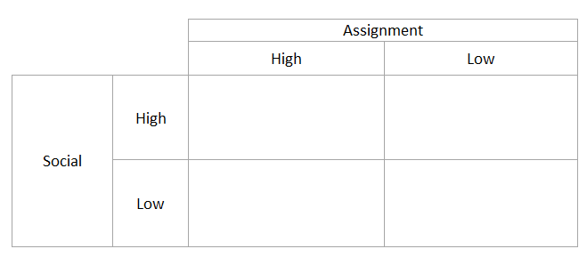
Team Effectiveness
Task effectiveness is the degree to which the team successfully achieves its task-related goals.
Social well-being refers to team members’ well-being, growth and development.
The team’s sustainability is the likelihood that the group will continue to cooperate and function effectively.
Well-functioning team
Reaches the set goals and participants thrive. The team is sustainable long term.
Cozy team
Does not reach the set goals but participants thrive. The team will have a short life span
Cold, efficient team
Reaches the set goals but participants do not thrive socially. The team has a short life span.
Dysfunctional team
Does not reach the set goals and participants do not thrive. The team has a very short life span.
Notes:
Ref: Michael A. West: Teamwork – methods for effective cooperation
It would be utopia to imagine that there is one right way to establish a team that works together effectively. Nowadays, most often conditions of the work place change and develop rapidly. This means that individuals, teams and organizations must be flexible if they are to be effective and sustainable.
For a team to function effectively, team members must actively focus on their goal (the task), their working methods and their social interactions. A well-functioning and effective team is consciously aware that the team consists of people with a number of different emotional, social and task-related needs which the team as a whole can either help to fulfill or work against.
Michael West proposes 3 main components of team efficiency:
Task efficiency is the degree to which the team successfully achieves its task-related goals.
Psychological well-being refers to the team members’ well-being, growth and development.
The team’s sustainability is the likelihood that the group will continue to cooperate and function effectively.
Michael West outlines a practical model for team cooperation (see slide). It may be used to describe a specific team – members may be involved in identifying themselves. His model illustrates 4 types of team cooperation and their most likely impact on the key results of the teamwork: task efficiency, members’ well-being and team sustainability.
Re well-functioning team: open communication around goals, processes, tasks and social welfare. Wish to cooperate.
Re cozy team: often the organization is not very satisfied with the team.
Re dysfunctional team: often severe conflicts between members themselves.
Re cold, efficient team: Members will often want to discontinue the cooperation despite a high degree of task efficiency.

Slide 39
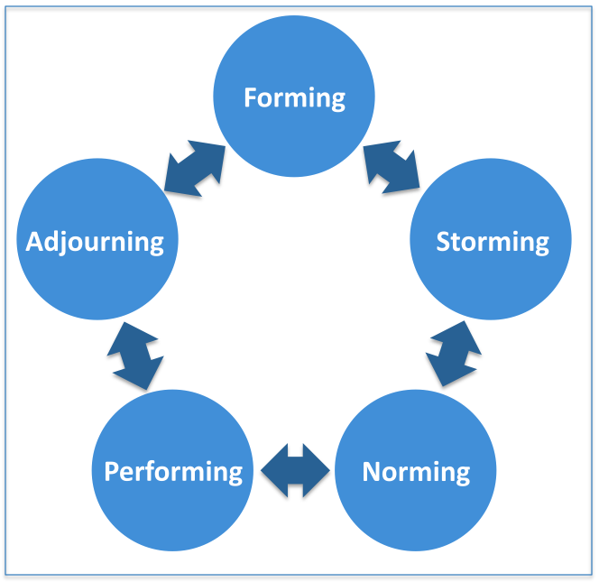
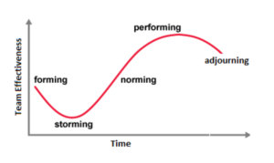
Team development
Source: Bruce W. Tuckman
Notes:
The Tuckman-model is old, but still relevant for group processes.
A newly established team must go through all these stages before it can perform optimally!
Group structure and task activities
1 Forming: The team is assembled. Who are we? What are we to do?
How? Who do we report to? Polite, tentative. Goals are defined.
2 Storming: The group trusts each other. Difficulties and conflicts related to coordinating and interpersonal relationships, common understanding, roles, sub groups are formed. The Storming stage ends when the group experiences cohesion.
3 Norming: Shared roles, routines and understanding. Resistance is gone. The group now experiences that they can express their personal and confidential opinions when it comes to the tasks. At this stage, therefore, they can begin to work effectively on their tasks and any conflicts will be handled through constructive discussion and negotiation.
4 Performing: Cooperation runs smoothly, tasks are being solved. The group can perform and deliver results. The interpersonal structure is now in place and can therefore become a tool for support in solving the group’s tasks. The group’s roles have become flexible and thereby functional. Focus is on collective decision making and cooperation.
5 Adjourning: The team is dissolved or moves on to new tasks.
Source: Tuckman, B., W. & Jensen, M.C. 1977. Stages of small Groups’ development revisited. Group and organizational studies.

Slide 40
topic – our team
Select and adjust the relevant slides
Replace analyses with the team’s own analyses
Delete the other slides
Delete these instructions

Slide 41
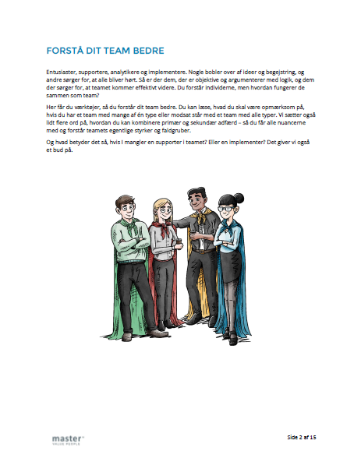
The report ”Understand your team”
The report ”Understand your team” provides tools for getting a better understanding of your team.
It tells you what to pay attention to if you have a team with many people of one type or the contrary, if you have a team that represents all the types.
It also provides additional advice on how you might combine primary and secondary behavior – in order to utilize all the nuances and understand your team’s real strengths and pitfalls.
So what does it mean, if your team lacks a supporter? Or an implementer? This report offers a suggestion.
Download the report here:
https://master.dk/loesninger/easi/easi-materiale/
Notes:
This description is for the instructor and should be deleted from the final presentation.

Slide 42
All the types are equally important
Companies with a high degree of diversity earn an average of 12.6 percentage points more than companies with less diversity in their teams.
Teams with high diversity are the ideal.
However, diversity requires acknowledging each other’s differences.
All types are equally important.
Differences help develop a team culture and increase productivity.
Source: Mckinsey
Notes:
The awareness that all types are equally important while at the same time – from a team perspective – it is essential to keep a focus on diversity and competence development.
Which team profiles/competences does our company possess?
Which team profiles/competences does the team need in order to complete its task?
Example questions for the team:
Which tasks do we currently solve in our team?
Which tasks will we need to solve in the future?
Which competences will our team need to have/build in the future?
Source: [2] http://www.mckinsey.com/business-functions/organization/our-insights/why-diversity-matters

Slide 43
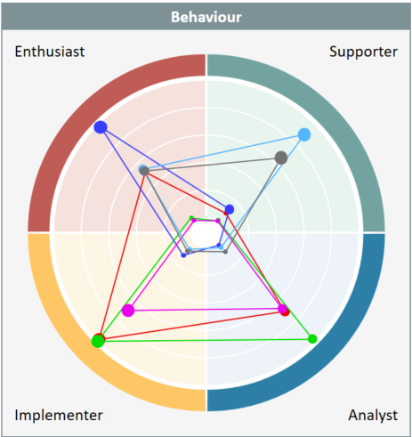
Your team
Notes:
Insert your own team analysis of the team. This is an example that shows all the team’s profiles. For more guidance see: https://youtu.be/m-6PPyAsNRk
Use the image as a starting point for talking about ”how your team looks” and as an introduction to the following images where we will go into more depth with what the team shows others and how EASI can help to indicate/point to focus areas.
One focus area might be that you look at competence development in a team perspective:
Which team profiles/competences does our company possess?
Which team profiles/competences does the team need in order to complete the task?
Example questions for the team:
Which tasks do we currently solve in the team?
Which tasks will we need to solve in the future?
Which competences will our team need to have/build in the future?

Slide 44
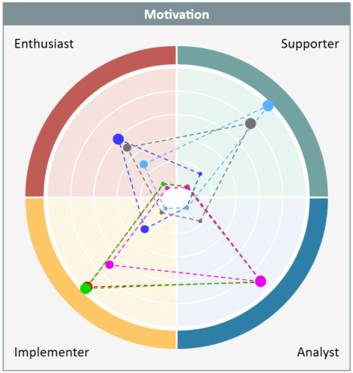
Your team
Notes:
Insert your own team analysis of your team. This is an example that shows all the team’s profiles. For more guidance see: https://youtu.be/m-6PPyAsNRk
Use the image as a starting point for talking about ”how your team looks” and as an introduction to the following images where we will go into more depth with what the team shows others and how EASI can help to indicate/point to focus areas.
One focus area might be that you look at competence development in a team perspective:
Which team profiles/competences does our company possess?
Which team profiles/competences does the team need in order to complete the task?
Example questions for the team:
Which tasks do we currently solve in the team?
Which tasks will we need to solve in the future?
Which competences will our team need to have/build in the future?

Slide 45
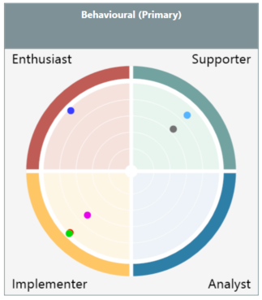
Your team’s collective primary behavior
Notes:
Insert your own team analysis of your team. This is just an example that shows the team’s primary behavior. For more guidance see: https://youtu.be/m-6PPyAsNRk
Use the image as a starting point for talking about ‘what does this behavior say about your team’, where are the team’s strengths and its development areas.
It makes good sense to go more into depth with the team’s behavioral preferences. As an example you could say about the above team:
4 persons indicate controlling behavior (E & I) while 2 indicate participating behavior.
Are there challenges between you about the way you want to control the team (split with 1 E’s & 3 I’s) and what does that mean for your cooperation, synergies and conflicts?
There are 2 Supporters in the team to ensure a focus on relationships and team cooperation.
What does it bring the team that there is a great focus on cohesion within the team?
There are no Analysts to go into details with tasks.
How can the team secure the contributions otherwise undertaken by an Analyst?
For more guidance, please refer to the report ”Understand your team”.

Slide 46
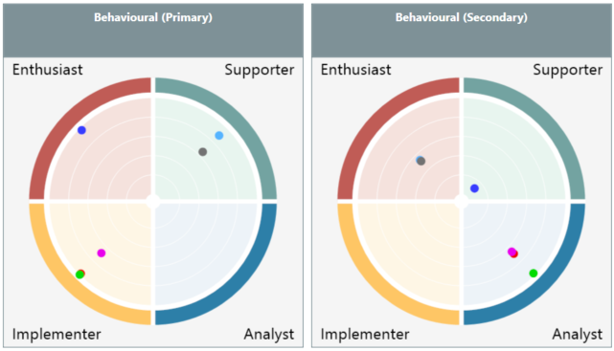
Your team’s primary/secondary behavior
Notes:
Insert your own team analysis of your team. This is an example that shows team’s primary and secondary behavior. For more guidance see: https://youtu.be/m-6PPyAsNRk
Use the image as a starting point for dwelling on nuances of behavior by including secondary behavior.
When you look at the above, for example, the team’s primary behavior gains some nuance from the secondary Analyst behavior.
For more guidance, please refer to the report ”Understand your team”, where you can also read more about secondary behavior.

Slide 47
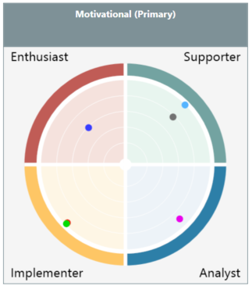
Your team’s collective primary behavior
Notes:
Insert your own team analysis of your team. This is just an example that shows the team’s primary motivation. For more guidance see: https://youtu.be/m-6PPyAsNRk
Use the image as a starting point for talking about ”what your motivation says about your team”, what the team is motivated by and where this differs from the team’s behavior and potential development areas.
The team’s motivation:
-5 team members indicate cooperative behavior split with 2 in S and 1 in A.
-Motivation is aimed almost equally at People and Task. About the motivation of the team as a whole it can be said that there is a slight tendency toward cooperation.
What does this mean in relation to the team’s behavioral preferences and what does it mean for the team that it’s motivation differs from its behavior?
Do some team members choose different behavior because there is not enough room to behave according to their primary motivation?
For more guidance, please refer to the report ”Understand your team”.

Slide 48
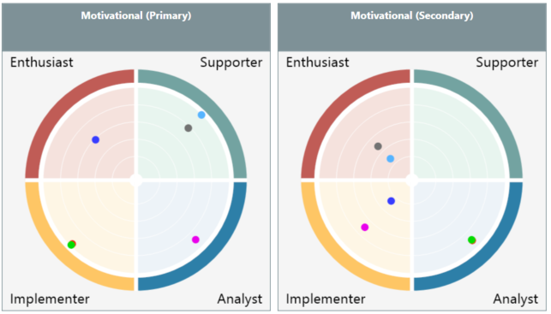
Your team’s primary/secondary Motivation
Notes:
Insert your own team analysis of your team. This is just an example that shows the team’s primary/secondary motivation. For more guidance see: https://youtu.be/m-6PPyAsNRk
Use the image as a starting point for expanding on nuances within motivation by drawing on information about the secondary motivation.
When we look at the above, the team’s motivation is shown for example by all team members being primarily or secondarily motivated for Control, either as an Enthusiast or as an Implementer.
For more guidance, please refer to the report ”Understand your team” where you can read more about secondary motivation.

Slide 49
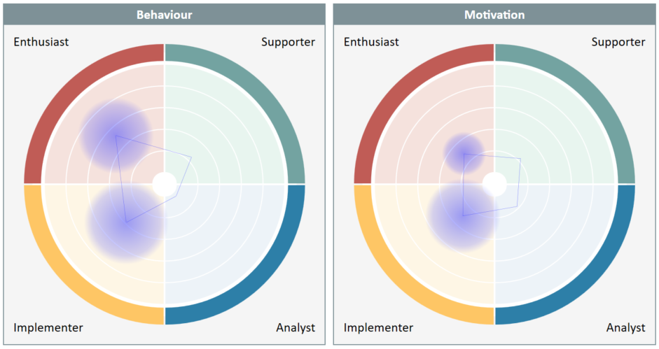
Your collective team preferences
Notes:
Insert your own team analysis of your team. This is just an example that shows (quite simply) which types mostly characterize the team as a whole. For more guidance see: https://youtu.be/m-6PPyAsNRk
Which two types stand out when you overlay all the team’s positions? How will others primarily perceive your team when they meet/work with you as a team?
This image shows that the team is motivated to do what you do, because the round circles have the same position for both behavior and motivation.
Questions:
What does it mean that your team as a whole have a preference for being Enthusiasts and Implementers when you are solving tasks in your daily work?
What strengths/pitfalls does that bring in terms of succeeding with the core tasks of your team?

Slide 50
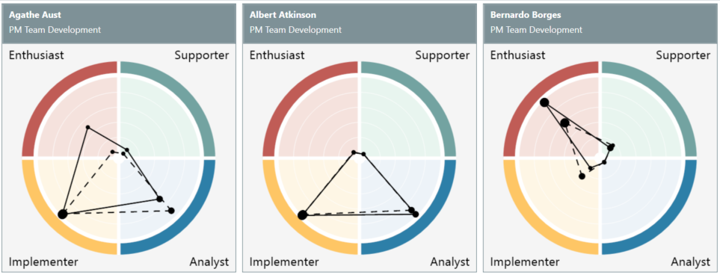
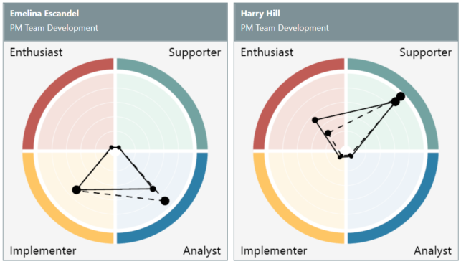
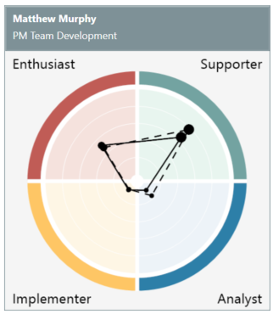
Your team preferences – individual
Notes:
Insert your own team analysis of your team. However, this is only relevant if you wish to show each individual’s EASI behavior and motivation.

Slide 51
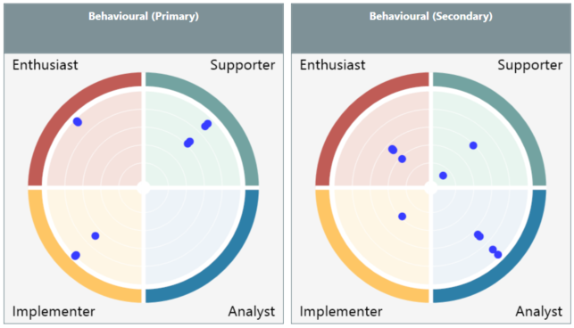
Your collective team preferences – behavior
Notes:
Insert your own team analysis of your team. For more guidance see: https://youtu.be/m-6PPyAsNRk
This is an example that shows both the team’s primary and secondary behavioral style in ‘neutral’ colors so you can focus on behavioral preferences of the team, not each individual.
You may find it useful to split the two images so you can show the primary behavioral first and only later extend to the secondary behavior.

Slide 52
topic – cooperation
Select and adjust the relevant slides
Delete the other slides
Delete these instructions

Slide 53
Definition of cooperation
Cooperation is most often about adapting to the needs of others.
Going forward, we want you to focus on how others perceive you.
Do not treat others as you would want them to treat you. ☺
All the 4 types have different preferences for how to cooperate.
Notes:
Cooperation is a term used in various areas of expertise: Cooperation in sociology is about separate group’s and culture’s efforts to reach a common goal.
Cooperation in economics is about employees’ and employers’ aligning their goals, demands and methods with each other.
Wikipedia
Working with EASI you should be aware that cooperation takes on a different meaning for each of the 4 types – see illustration on the next slide.

Slide 54
Preferences of the types
E
Person
S
Talkative
Tend to lead when cooperating
Enjoy setting the direction
Quick starter
Many ideas
Do well in creative processes
Might lose focus on completion
Gladly delegate tasks to others
Listen
May seem restrained
Appreciative
Consensus-seeking
Ask about alternatives
Want to bring everyone along
Often say ‘yes’ to assignments
Remember the different types around the table
Control
Participate
Talkative
Focus on goals and action
Gladly challenge others directly
Partially well-informed basis
Pragmatic
Prefer to take the lead quickly
Primarily want progress
May seem dominant
May steamroller others
Think
Focus on details
Thorough preparation
Challenge/have many questions
Want to avoid mistakes
Ensure quality
Double check
Might ‘kill’ ideas
Might lose sight of the big picture
I
A
Task
Notes:
The natural preferences of the types when they work together.
Do you recognize the types from your own cooperation?
What can you do to strengthen your cooperation?
Where can you make adjustments, up or down?

Slide 55
Motivation of the types
E
Person
S
Excitement
Room for emotions and ideas
Extraverted activities
Opportunity to influence others
Experiments
Spontaneity
Open to inspiration.
Care for each other
Pleasant tone
Sympathy and acceptance
Presence
High degree of involvement
Concerned with ensuring the anchoring of decisions
Control
Participate
Results
Efficiency
Pragmatic approach
Direct tone
Quick to go from thought to action
Fast decisions
Demand steering
Independent
Time for immersion
Systematic
Objective
Facts
Analyze and judge
Correctness
Want realistic deadlines
I
A
Task
Notes:
What is the high-level motivation for cooperation of the types?
What are their driving forces and when are they most motivated?

Slide 56
exercises – cooperation
Select and adjust the relevant slides
Delete the other slides
Delete these instructions

Slide 57
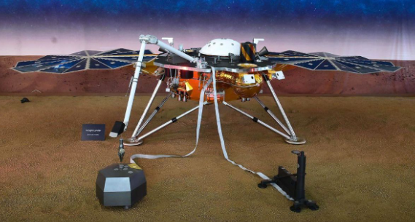
Landing on mars
You have to help NASA build a prototype of a landing vehicle that can land safely on Mars. The vehicle must be able to withstand a 3-meter drop without the egg breaking.
Important information
The egg may only be protected by the materials you are given.
The egg must be transported without any contact with or assistance from people or equipment.
The egg may not be fried nor boiled – it must remain raw.
You may not introduce any energy into the egg – it must be moved by gravity alone.
The egg must be visible through the structure.
The egg must not be attached, but must lie loose.
In 15 minutes your vehicle will be dropped!
Notes:
See description of the exercise on the next slide.
3-12 participants per group. Set aside 15 minutes for building and 10 minutes for debrief.

Slide 58
Description of the exercise ”Landing on mars”
Purpose: Team exercise with a strong focus on the primary behavior of the team and the individuals
Materials: Straws, tape, scissors, eggs, strings, balloons, paper, paper clips and rubber bands.
Exercise: Hand out the materials and tell the teams that they must help NASA build a prototype of a landing vehicle that can land safely on Mars. Show the participants where you plan to land the vehicle so they know the size of the vehicle. The vehicle must be able to drop 3 meters without the egg breaking. (Be prepared that the eggs might break).
If you wish to activate different persons and types during the exercise, you can start the exercise without a time limit. After 5 minutes you introduce the time limit and observe how the group reacts to this. (Do some of them become more active/passive?).
In the final 5 minutes you can add that the vehicle will be a flagship for NASA and that 4 billion people will watch it live on TV. So the vehicle should look good. (Notice who takes on this new task).
Variation: You can assign one of the participants on each team a “secret” role as observer of the process. This is to ensure that you have observations from the group, even if the process becomes very hectic.
Evaluation: What behavior was dominant during the exercise? Did it change during the course of the exercise? Which behavior mostly contributed to solving the task? Who might have contributed more in terms of solving the task and running the process? Which behavior was lacking in order to solve the task?
Notes:
This description is for the instructor and should be deleted from the final presentation.

Slide 59
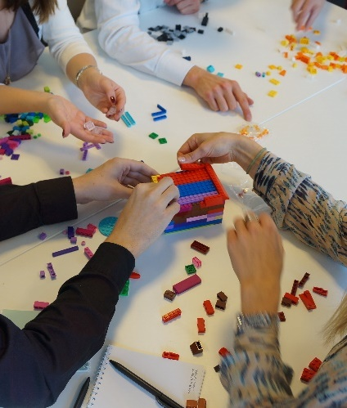
Build a house
Each group is to build a house that they can ”live” in.
Assign an observer in each group, who will present their result in plenary afterward.
Notes:
See description of the exercise on the next slide.
Set aside 10 minutes for building and 5 minutes for each group to present.

Slide 60
Description of the exercise ”Build a house”
Purpose: To show the types’ influence on cooperation in practice.
Materials: Lego bricks and printed observation guide.
Exercise: Split the participants into groups based on their types. Preferably groups of 4 with the same type. Alternatively Supporters/Analysts and Implementers/Enthusiasts in two groups.
Each group is to build a house, that they can “live” in. Each group gets a box of Legos. Each group selects an observer who will not participate but only observe and later present in plenary.
Follow up and outcome of the exercise will be discussed in plenary afterward.
Notes:
This description is for the instructor and should be deleted from the final presentation.
See the observation guide for print on the next slide.

Slide 61
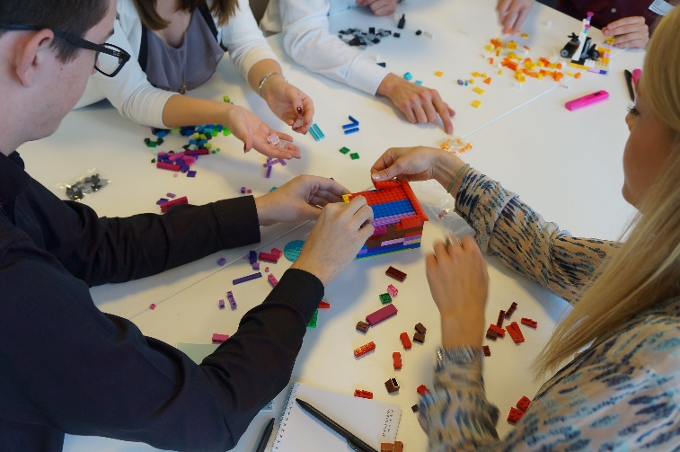
Observation guide for the exercise ”Build a house”
Your observations of the exercise ”Build a house”
Which type(s) did the group consist of?
Did the group make a strategy? Did all the group members agree on the strategy?
Was everyone in the group satisfied with the result?
How did you recognize the types (behavior, body language, role taken in discussions, visibility etc.)?
What influence did it have that these types were represented in discussions and in the group’s work?
Notes:
See description of the exercise on the next slide.
Print the observation guide and hand it to the observers in each group. Do not show this in the presentation.

Slide 62
Complete an assignment together
You are part of a group that is tasked with solving a problem together.
However, the rest of your group is not present to help with your part of the task and you don’t know what the ultimate result/goal is to be.
Therefore, you have to solve your part of the task alone.
Notes:
See description of the exercise on the next slide.
There must be at least 10 participants and the exercise takes approx. 30 minutes.

Slide 63
Description of the exercise ”complete an assignment together”
Purpose: The exercise helps to teach participants that each individual employee’s work and behavior contributes to their shared task/strategy and that all the types can support the same activity despite having limited information/communication.
Materials: A photo/drawing/illustration (A4 size) without too much detail, that is cut into equal parts. Each participant gets one piece of the illustration. Hand out pencils, markers/crayons, rulers, paper and scissors to each participant. And tape to put together all the pieces at the end.
Exercise: Each participant is instructed to create an exact copy of the piece of the illustration that they receive, but five times bigger. The only thing each participant knows, is that he/she has to enlarge their picture and that their individual task is intended to contribute to the group’s collective goal – nothing more.
When the participants gather in the plenary room and all are present, they will be asked to put all their pieces together as one whole completed assignment.
Message to each participant:
You have received a miniature model of your part of the assignment. You have to create an exact copy of your model – BUT your copy must be 5 times bigger. You have 20 minutes to solve your part of the assignment. After you complete the task, please bring it to the plenary room.
Continues on the next slide….
Notes:
This description is for the instructor and should be deleted from the final presentation.
See the observation guide for print on the next slide.

Slide 64
Description of the exercise ”complete an assignment together”
continued…
Observations: Depending on their type, some will be fast and not very careful, others will need more information and take more care, yet others will be focused on what others are doing and thinking, and some will consider whether what they are doing makes sense.
When you gather in plenary, notice what happens. Who takes the lead/initiative? Who sticks to the instructions?
Reflections: What does it mean to each type that the information given is short and not necessarily sufficient?
What does it mean to each type that they can only influence a small part of the process?
How does the company’s/manager’s/colleague’s communication influence my behavior?
What happened when the whole group had to put together their pieces? How did they communicate? How well did they succeed with the assignment?
Is this an illustration of how we see our cooperation/communication in daily work life?
Notes:
This description is for the instructor and should be deleted from the final presentation.
See the observation guide for print on the next slide.

Slide 65
Topic – strengths and pitfalls
Select and adjust the relevant slides
Replace analyses with the team’s own analyses
Delete the other slides
Delete these instructions
Notes:
Pitfalls of your strengths
Can a strength be over-used? Yes, it can. If we don’t focus on using our strengths in an appropriate way relative to the situation (school, work, leisure time, family, partner, children, friends, colleagues, ourselves) we risk using them and causing undesirable side effects.
A useful way to ensure that this doesn’t happen is to work on what we call the pitfall of your strength.
The pitfall of your strength is:
A way to become aware of what pitfalls or development areas your strengths have.
A way to become aware of how to manage your strengths in a meaningful and constructive way.
A way to work on improving the flipside of your strength, while maintaining and developing the strength itself.
For example it may be that your strength needs support in order to be utilized optimally in a group/team. It could be from someone who complements your strength’s flipside. Someone who is strong where you are less strong.
Or maybe you need to develop in other areas in order to really bring your strength into play.
When this type of dialog occurs in a group/team – about how we can best support each other and develop in such a way that our unique strengths are allowed to thrive – this is your foundation for an effective strength-based group/team.

Slide 66
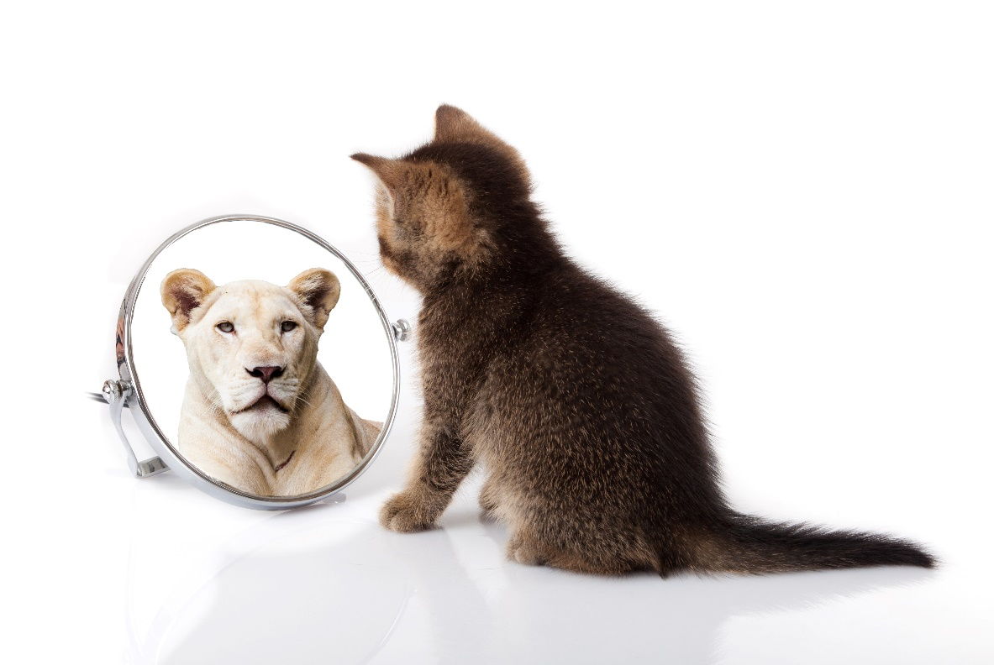
strengths and pitfalls
Any strength has the potential to become a pitfall.
The stronger our strength is, the easier it can turn into a pitfall, a so-called ”blind spot”.
The key is to hold on to the strength and improve on the pitfall.
Notes:
Strengths and pitfalls.
Can a strength be over-used? Yes, it can. If we don’t focus on using our strengths in an appropriate way relative to the situation (school, work, leisure time, family, partner, children, friends, colleagues, ourselves) we risk using them and causing undesirable side effects.
A constructive way to ensure this doesn’t happen is to work on your strengths and pitfalls.
A way to become aware of how to manage your strengths in a meaningful and constructive way.
A way to work on improving the flipside of your strength, while maintaining and developing the strength itself.
Maybe you need to develop in other areas in order to really bring your strength into play.

Slide 67
strengths and pitfalls
Person
E
Strengths:
Open, excited, initiating, inspiring, interesting, energetic
Pitfalls:
Superficial, too toward, exaggerate, impatient. Lack preparation and needs clarification
Strengths:
Appreciative, friendly, cooperative, trustworthy, diplomatic, welcoming
Pitfalls:
Shy away from conflicts, ambiguous, indecisive, reluctant, may come across as sensitive.
S
Control
Participate
Strengths:
Goal-oriented, determined, control situations, effective, decisive, progress
Pitfalls:
Impatient, unpleasant, too quick, steamroller, forget to bring others onboard
Strengths:
Analyzing, detailed, structured, methodical, well-prepared, thorough.
Pitfalls :
Static, stubborn, critical, closed/distant, opinionated, perfectionist
I
A
Task
Notes:
Description of each type’s strengths and pitfalls. Notice that it’s by working on your pitfalls that you can develop and grow.

Slide 68
Your collective team
Notes:
Insert your own team analysis of your team. This is just an example that shows what characterizes your team as a whole and which two types stand out when you overlay all the team’s positions.
What strengths does this bring out about your team and which pitfalls do you need to pay attention to and work on?

Slide 69
Exercises – strengths and pitfalls
Select and adjust the relevant slides
Delete the other slides
Delete these instructions

Slide 70
Your team’s strengths and pitfalls
The way your group cooperates and communicates is key to the task you share. A greater insight into the types comprised by your group can help improve your understanding of the team’s collective strengths and weaknesses.
Group work:
What strengths does your team have?
What pitfalls does your team have?
What does this mean to how you can solve your core tasks?
Notes:
Group work for 30 minutes. Then presentation for 5 minutes per group.

Slide 71
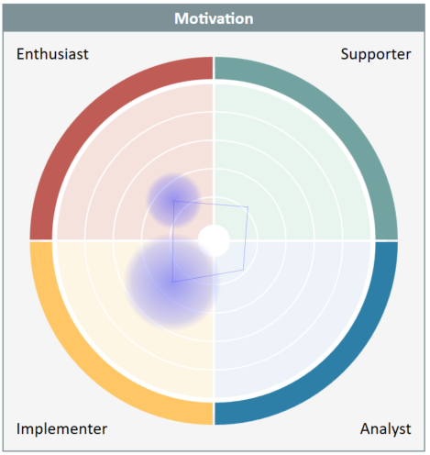
Analysis of my group
Internally in the group:
What strengths do we have between us and how do they manifest themselves in our daily work?
What are our weaknesses and how do they manifest?
Outside the group:
How do we show our group’s strengths externally? To whom and how?
How do our group’s weaknesses come across to others?
Notes:
See description of the exercise on the next slide.

Slide 72
Description of the exercise ”Analysis of my group”
Purpose: A greater insight and understanding of the group’s composition of types can contribute to promoting an understanding of the group’s strengths and weaknesses.
Materials: Make sure all participants have filled in an EASI profile about their behavior. Run the Team analysis about behavior and copy the analysis into the slide above.
Exercise: The group discusses the questions on the previous slide. Then they present their points in plenary.
Observations: Be aware that the focus on dialogue is part of the group’s behavior, not individual behavior. Keep an eye on participants to see if they are all engaged in the conversation. Notice whether participants display behavior during group work that reflects their usual work/behavior. For example quick, detail-oriented or lose focus on the task.
Reflections: How did the participants perceive this exercise? What was difficult/easy? Which behavior did the group experience during the group work? Can they draw parallels to their daily work? How might the group use this experience in their work going forward?
Notes:
This description is for the instructor and should be deleted from the final presentation.

Slide 73
Strengths & Pitfalls
Make groups to fill in one framework for each person in the group in turn.
The focus person sits with his/her back against the group and may not communicate anything by speech nor body language.
While the group fills in the framework:
Speak clearly so the focus person can hear everything.
Make sure to distinguish between:
Real observations of the focus person (What? Where? When?)
Hypotheses about the focus person (Why do you think this?)
After you fill in the framework:
The focus person turns to face the group and shares how he/she experienced this exercise..
The focus person says whether he/she agrees with the rest of the group.
Strength:
Provoked by:
Pitfall:
Development point:
Notes:
For groups of 3-4 persons who work together in daily work and have all filled in an EASI profile.
For example 15 minutes for preparation and 20 minutes per participant for feedback.

Slide 74
Description of the exercise ”Strengths & Pitfalls”
Purpose: To increase each individual’s awareness of his/her own strengths and pitfalls as well as any potential development areas in relation to other people. Also builds the group’s and individual’s skills in constructive feedback.
Materials: Print the work sheets for the groups, so they can fill one in for each participant.
Exercise: Is described on the previous slide. Remember to check first, whether there are any difficult unresolved conflicts between any of the participants. Consider which types you put together in the groups.
Observations: Keep an eye on whether the groups work constructively and appreciatively. Accept if someone does not want to have a turn as focus person in this exercise. Notice whether the composition of types means anything for how the group cooperates (openness/focus/patience).
Reflections: How can this exercise/method be applied in your daily life?
What was it like to be the focus person?
How did the group cooperate? Did the group recognize the typologies as they relate to behavior in the group?
How good are we at giving constructive feedback in our everyday life?
Notes:
This description is for the instructor and should be deleted from the final presentation.

Slide 75
Example of a filled in strengths & Weaknesses framework
Strength:
FAST
Provoked by:
Pitfall:
A THOROUGH AND CAREFUL PERSON
SLOPPY
Development point:
ALWAYS CHECK AGAIN
Notes:
Start with your strength.
If the strength is exaggerated it becomes a pitfall (disadvantage)
The pitfall is an exaggeration/distortion of the strength – not its opposite.
Many people describe themselves by their “strengths” whereas others describe themselves by their “pitfalls”.
The pitfall leads to a development point .
The development point is what you should do to avoid your pitfall and at the same time maintain your strength…
This means that others, who are particularly good at what is our development point, might annoy us.
We tend to be provoked when people do a lot of what we ourselves need to do more…
The pitfall is not the opposite – for example the pitfall of decisiveness is not indecisiveness!

Slide 76
Example of a filled in strengths & Weaknesses framework
Strength:
TAKES ACTION
Provoked by:
Pitfall:
A DEPENDENT PERSON
BULLDOZES
Development point:
BRING OTHERS ALONG FOR GREATER IMPACT
Notes:
Start with your strength.
If the strength is exaggerated it becomes a pitfall (disadvantage)
The pitfall is an exaggeration/distortion of the strength – not its opposite.
Many people describe themselves by their “strengths” whereas others describe themselves by their “pitfalls”.
The pitfall leads to a development point .
The development point is what you should do to avoid your pitfall and at the same time maintain your strength…
This means that others, who are particularly good at what is our development point, might annoy us.
We tend to be provoked when people do a lot of what we ourselves need to do more…
The pitfall is not the opposite – for example the pitfall of decisiveness is not indecisiveness!

Slide 77
EASI strengths & Weaknesses FRAMEWORK
Strength:
Provoked by:
Pitfall:
Development point:
Notes:
Print this framework so all the groups can fill in one per participant.
Strengths: Your strength should be maintained.
Pitfalls: You should increase your awareness of when and with whom you most often fall into this situation. You should learn to recognize the warning signs.
Development points: you should understand what you need to do about them. You should learn to understand why that is difficult for you.
Provoked by: These provoking people in particular are a great source of inspiration.

Slide 78
TOPIC – motivation
Select and adjust the relevant slides
Replace analyses with the team’s own analyses
Delete the other slides
Delete these instructions

Slide 79
BEHAVIOR VERSUS motivation
Behavior: What we do in our daily work.
Motivation: What makes us thrive in our work situation.
Behavior
What we
actually do
MOTIVATION
What makes us thrive
Ideal
state
Notes:
In an ideal world our behavior and our motivation would be a perfect match. In the real world, though, they are never 100% aligned. Sometimes we have to do things we are not motivated to do, and other times we have to skip doing something that we are very motivated to do.
By being aware of our actual behavior and our preferred behavior each of us can strengthen our ability to align our behavior and our motivation.

Slide 80
Maslow’s pyramid of needs
Selfactualization
Self-esteem
Love & belonging
Safety & security
Physiological needs
Notes:
How can Maslow’s theory help us understand another person’s motivation?
We can’t expect a person to be motivated at a given level if one or more of the lower needs in their pyramid is not fulfilled.
For example, it is difficult to motivate a person to become a leader (esteem) if that person does not feel accepted by his/her employees (love and belonging).
Need for self-actualization: Recognition and realization of one’s own potential, for example the realization of personal potential, self-actualization, personal development and experiences of peaks in life.
Need for esteem: Self confidence, recognition, appreciation and respect from others, for example results, abilities, status, prestige, leadership responsibility etc.
Need for love and belonging: Love and intimacy through partners, family and groups, such as work groups, family, love/friendships, relationships etc.
Need for safety and security: Stable, well-known surroundings free from fear and anxiety, both psychological and economical, for example protection against threats, security, law and order, borders etc.
Need for survival: Physiological needs such as food, water, shelter, sleep etc.
(Abraham Maslow, 1954, 1970)

Slide 81
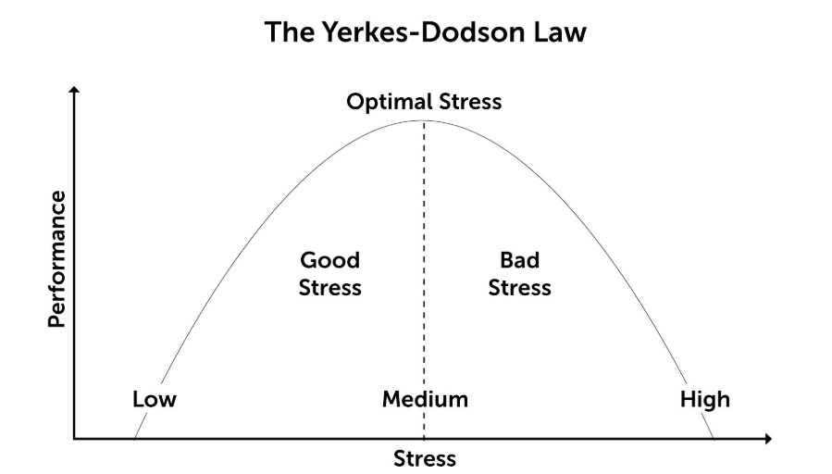
Arousal level
The ”Optimum Level of Arousal” = OLA
Can be affect by the following:
Inner stress tolerance
Mental abilities
Need for stimulation
Outer stress tolerance
Outer stress factors
Support/assistance from others
Curiosity/interest
Robert M. Yerkes (1876-1956) and John D. Dodson (1879-1955) described how human performance depends on whether we are stimulated at the right level (Optimal Level of Arousal, OLA). Both over and under stimulation make us perform worse.
Notes:
How can the ideal level of arousal (OLA) help us to understand other people’s motivation?
Are they over-/understimulated by their current tasks?
What might be the cause of this?
Stress tolerance (inner):
Mental abilities – are the tasks too easy? Or too difficult?
Need for stimulation – are the tasks boring? Or too ”dangerous”?
Stress tolerance (external):
External stress factors – what else is going on in their lives?
Support from others – colleagues? Management? Others?
Curiosity/interest – what arouses their interest?

Slide 82
habits
Habits are strong motivators: We generally prefer to see and do thing the way we are used to.
Habits arise from:
What we personally prefer to do.
What we believe is the right thing to do.
What we have "always” done.
It is important to distinguish between these!
Notes:
Here’s an example of how habits can be established: A person always prints his/her emails.
Habit as a consequence of personal preference: This person does it, because he/she doesn’t like to read text on the computer screen.
Habit as a consequence of opinion/belief: When emails were launched, software was unstable and you had to print emails to secure documentation (luckily this is not the case anymore, but this person still prints out of habit).
Habit as a consequence of what the person ”has always done”: The reason is long since forgotten, yet the person continues to do it. Remember that a reason might still be valid, even if it has been forgotten. For example, in this case it might be necessary to print emails for auditing (even though no one remembers that reason at the time of printing).

Slide 83
Goals & objectives
Goals & objectives motivate us.
Especially when we:
Are personally engaged in achieving the goal
Get feedback on our results
Are rewarded for achieving a goal
Have the necessary skills and abilities to achieve the goal
Are encouraged by management or others
Notes:
Goal-setting theory (Locke, 1981)
Through scientific research Locke established that goal setting leads to improved performance in 90% of cases, especially under the following conditions:
Engagement: The person accepts the specific goal
Feedback: The person gets feedback regarding the results achieved as a way to reach the goal.
Reward: The person is rewarded for reaching the goal.
Abilities: The person has the necessary skills to reach the goal.
Support: Management and others encourage the person to reach the goal.
(Eysenck, 2001)

Slide 84
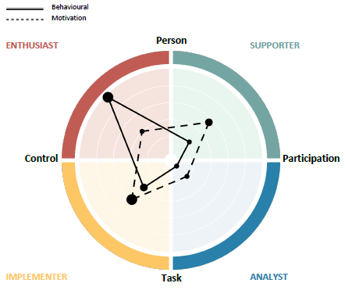
GAp analysis – What can we see?
Notes:
This image is an example from an EASI report that is used to talk with the team about behavior and motivation.
What thoughts might we have on the person’s behavior and motivation?
Drawing on the previous slides about motivation, you might ask the participants to form hypotheses about what the differences in behavior and motivation indicate.

Slide 85
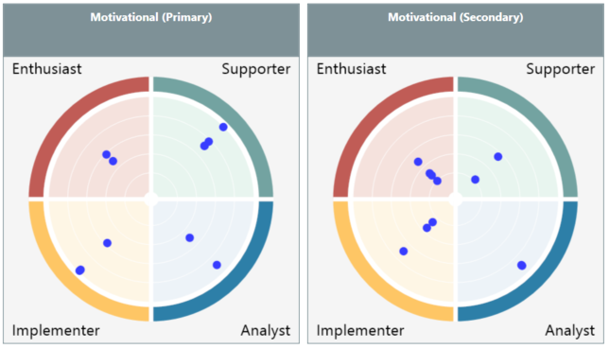
Your team’s collective motivation
Notes:
This image may be used to talk with the team about what they can deduce from their whole team’s primary and secondary motivation
What are their thoughts on this?

Slide 86
motivation and drivers
E
Person
S
Development
Relationship
Control
Participate
Results
Quality
I
A
Task
Notes:
Headlines for the 4 types’ motivation and drivers

Slide 87
Motivation in cooperation
E
Person
S
Excitement
Room for emotions and ideas
Extraverted activities
Opportunity to influence others
Experiments
Spontaneity
Open to inspiration.
Care for each other
Pleasant tone
Sympathy and acceptance
Presence
High degree of involvement
Concerned with ensuring the anchoring of decisions
Control
Participate
Results
Efficiency
Pragmatic approach
Direct tone
Quick to go from thought to action
Fast decisions
Demand steering
Independent
Time for immersion
Systematic
Objective
Facts
Analyze and judge
Correctness
Want realistic deadlines
I
A
Task
Notes:
What motivates the types?
Can the team’s core tasks meet the motivations of the 4 types?

Slide 88
Exercises – motivation
Select and adjust the relevant slides
Delete the other slides
Delete these instructions

Slide 89
Motivation in your team
Internally in the group:
What are the primary driving factors of our group – in relation to the analysis?
How do these ”drivers” manifest themselves in our daily work?
What happens with the group if one or more group members are not motivated?
What would it take for the group to achieve optimal motivation? What initiatives can we take?
Notes:
Groups of 4-12 persons (multiple groups can work simultaneously).
Group work approx. 30 minutes. Presentation 5 minutes per group.

Slide 90
Description of the exercise “Motivation in your team”
Purpose: An increased awareness and understanding of the group’s composition of types can contribute to the understanding of the group’s motivational drivers. The purpose of this exercise is to focus on the group’s motivation in their daily work and relationships.
Materials: Make sure all participants have completed the EASI test on motivation. Make the Team analysis on motivation and copy it into the slide above.
Exercise: The group discusses the questions on the previous slide. Then they present their findings in plenary.
Observations: Ensure that the focus of the dialogue is on the group’s motivation, rather than individual motivation. Keep an eye on whether all participants are engaged in the conversation. Notice whether the participants display behavior during the group work that reflects their daily work/behavior. For example, fast, detail-oriented, get distracted.
Reflections: How did the participants experience this exercise? Was it difficult/easy? What behavior did the group notice during the group work? Can they draw parallels to their daily work? How can the group use this conversation going forward?
Notes:
This description is for the instructor and should be deleted from the final presentation.

Slide 91
topic – spot a type
Select and adjust the relevant slides
Delete the other slides
Delete these instructions

Slide 92
Spot a customer type
Person
E
S
^{Customer expects:}
^{Excitement, news, originality.}
^{Customer rejects:} ^{Details, long explanations.}
^{Customer expects:}
Empathy, sincerity, trust, patience.
^{Customer rejects:}
Pressure and quick decisions without ownership.
Control
Participate
^{Customer expects:}
Focus on results, facts, professionalism, straight-forward communication
^{Customer rejects:} ^{Small-talk, inefficiency.}
^{Customer expects:}
Well-prepared and restrained sales people, professional knowledge, thoroughness.
^{Customer rejects:} Promises of more than you can keep.
I
A
Task
Notes:
This model serves as inspiration for how you might spot your customers’ types through EASI.

Slide 93
Exercises – spot a type
Select and adjust the relevant slides
Delete the other slides
Delete these instructions

Slide 94
Which types are in play?
Harold (calls): Hi Greta. Didn’t you receive my email? I need an answer from you in order to move forward with my task, so I can complete it.
Ginger: Yes, I’ve seen your email and I would really like to help. But I think I need to run it by my colleague, Marcus. It’s his area, you see, so I think I should involve him. But he’s on vacation now, I’m afraid. Maybe it can wait until he’s back?
Harold: No, I can’t wait a week. I need to get on with this task and I don’t think it’s very efficient if we have to wait for Marcus to return. Can’t you just look at it and give me an answer?
Ginger: Well, I don’t know. I would like to help you, but I’m not sure how Marcus would feel about it. It’s his area, you know.
Harold: I’ll deal with Marcus when he’s back. I don’t have time to wait. Just give me a quick answer.
Ginger: Yes but I’m not sure. Then I will have to discuss it with Carl for sure….
Notes:
See description of the exercise on the next slide.
A plenary exercise – approx. 10 minutes.

Slide 95
Which types are in play?
Martin comes by: I’m just checking out a super exciting opportunity. I have an amazing idea for how we can get a lot of new customers. It would be awesome if you and I could spend even just half an hour on some quick sparring.
Alan (colleague) calls): Hi Bridget. Didn’t you get my email? I need an answer from you in order to move forward with my task, so I can complete it.
Lucas calls HR: Hi, I don’t know if you can help me. I’m not quite sure if I can actually use my health insurance. But I talked with a colleague who has been through something similar and she definitely thinks that I should be covered.
Notes:
See description of the exercise on the next slide.
A plenary exercise – approx. 10 minutes.

Slide 96
Description of the exercise ” Which types are in play?”
Purpose: To be able to spot which type a person is.
Materials: The two previous slides
Exercise: Everyone discusses which types they think are in play and state their arguments for why.
The correct types:
Harold is an Implementer
Ginger is a Supporter
Martin is an Enthusiast
Alan is an Implementer
Lucas is a Supporter
Notes:
This description is for the instructor and should be deleted from the final presentation.

Slide 97
Do you recognize the type?
Each group is tasked with describing/showing/presenting your own type (eg. Enthusiasts) in plenary to the other 3 types (eg. Supporter, Analyst, Implementer).
Your presentation should include:
Your strengths when cooperating with the 3 other types
Your challenges/pitfalls when cooperating with the 3 other types
The group may choose how to present and which aids they want to use (illustrations are encouraged).
Notes:
Minimum 6 participants. All 4 types should ideally be represented.
Group work 30 minutes. Presentation 5 minutes per group.

Slide 98
Description of the exercise ”Do you recognize the type?”
Purpose: To quickly give participants a greater insight into their own typology. Then to present themselves to the other EASI typologies Based on their own insights and using their own words.
Materials: All participants must have completed an EASI test so they know what their type is.
For use in the presentation you can provide all kinds of “paraphernalia” – such as paper, Legos, hats – imagination is the only limit.
Exercise: Make groups consisting of only one type each (make more groups with the same type, if you have many participants). The groups are tasked with describing/telling/performing their own type and present it to the other 3 types in plenary.
Notes:
This description is for the instructor and should be deleted from the final presentation.

Slide 99
topic – communication
Select and adjust the relevant slides
Delete the other slides
Delete these instructions

Slide 100
We cannot ”not communicate”
In statements regarding feelings and opinions the following holds true:
7 % of the message is conveyed by the words used.
38 % of the message is conveyed bÿ the way
the words are said.
55 % of the message is conveyed by facial expressions.
Source: Albert Mehrabian, 1981/2009
What we say
How we say it
Notes:
For more information about Albert Mehrabian please see his website at www.kaaj.com/psych.
7% by what we say – 93% by how we say it!
Try to illustrate this in practice:
1. We can’t not communicate:
Don’t say anything; just sit with your arms crossed and stare at a person ”How does this comes across?”
Slam a door: ”How am I (not) communicating now?”. ”When did I stop communicating?”
2. The message is conveyed through behavior and facial expressions: Find a short sentence that can mean very different things using the same words, but different stresses and intonation.

Slide 101
Communication examples
Enthusiast:
We’re going to spend 2 fantastic and inspiring days together, where we will share experiences and learn new ways to develop our organization…
Supporter:
We will spend 2 cozy days together. We will have a nice lunch together at noon. I hope you will all contribute…
Implementer:
We have 2 days to spend together. The goal is to teach you how you can create value for your organization by using a typology tool.
Analyst:
For the next 2 days we will be together from 9am to 4pm. Everything we teach is built on a solid foundation. We will go into detail with the typology tool…
Notes:
This is an example where you describe a 2-day course in different terms to accomodate the different types.
We should communicate differently because the types value different things.

Slide 102
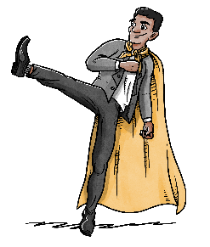
different meanings of the same word
Words can be interpreted in many ways. They are colored by our behavioral style and our experience.
For example, the word ”education" might mean:
Implementer:
New goals
Analyst:
New knowledge
Enthusiast:
New inspiration
Supporter:
New relationships
Notes:
This an example of how the word ”education” can be enterpreted differently by the types.
Exercise recommendation: Ask the participants how they perceive different words, for example ”good cooperation”. Common answers will be: Efficient (I), Innovative (E), Cozy (S), Orderly/systematic (A).

Slide 103
what do we say?
E
Person
S
Opportunities
Excitement
News value
Enthusiasm
Big picture
Feelings and values
Personal experiences
Unity
Recognition
Experiences
Control
Participate
Results
Progress
Efficiency
Goals
Decisions
Quality
Security
Plans and structure
Logic
Facts
I
A
Task
Notes:
This models serves as inspiration for what the types often talk about and which words they typically use. Not necessarily litterally, but with similar words.
What we say counts for 7% (How we say it counts for 93% - see next slide).

Slide 104
how do we say it?
Person
Many lively words
Open body language
Motivating intonation and body language
Loose structure/changes of subject
Lively and animated
Curious and informal
Spoken rather than written
Short overview
Preferably humorous and colorful
Diplomatic
Pleasant tone of voice
Welcoming
Communicate between the lines
Loose structure
Listening and patient
Accepting
Calm and present
Spoken rather than written
Honest and personal
Describe different points of view
E
S
Control
Participate
Short precise sentences
Powerful body language Direct and at times hurtful intonations
Stick with the ”issue”
Speak fast
Engaged and focused
Direct and convincing
Written or spoken – depending on what’s most efficient.
Many details
Fact-based sentences
Short sentences
Stick to the ”issue”
Seek objectivity
Subdued and formal
Well thought-through
Interested and calm
Structured
Preferably in writing
I
A
Task
Notes:
This models serves as inspiration for how the types communicate, i.g. in what way would we expect the types to communicate most often
What we say counts for 7% (How we say it counts for 93% - see the previous slide).

Slide 105
communication
Person
Focus: Something exciting, new, different, prestigous, make themselves seen
Your influence:
Preferably enthusiastic, excited, tuned in, sophisticated, curious
Don’t want to hear about the details!
Focus: Something nice, close, kind, comfortable, relationships with others, pleasing others and gaining sympathy
Your influence:
Kindness, friendliness, pleasant, calm, safe and trustworthy
Don’t want any pressure!
S
E
Control
Participate
Focus: Results, control, independence, progress, efficiency
Your influence:
Efficient, don’t waste time, straight to the point
Can’t stand small talk
Focus: Security, data, facts, guaranties, functionality, effective tools
Your influence:
Serious, well-prepared, knowledgeable, factual
Don’t want to promise more than they can keep!
I
A
Task
Notes:
This model intends to inspire and provide an overview of:
What the types are mostly focused on when they communicate
How the types most often communicate
What they seek to avoid when they communicate

Slide 106
exercises – communication
Select and adjust the relevant slides
Delete the other slides
Delete these instructions

Slide 107
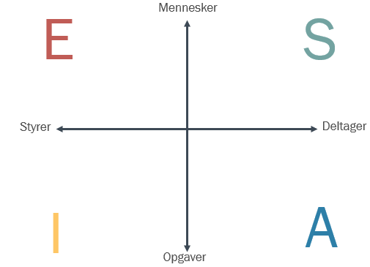
Refresh the types’ behavior
Everyone draws a cross on a piece of paper and fills in their own words for the preferred behavior of each type.
What does each type do often? E.g. listen, interrupt, look into someone’s eyes, get ideas, cut through etc.
It’s not important to use the correct EASI words.
Person
Control
Participate
Task
Notes:
An exercise for participants who have prior knowledge of EASI
The exercise provides the instructor with a sense of whether the participants have a good understanding of the differences between the types.
Spend 10 minutes describing each type. Debrief in plenary for 10 minutes
You might print the EASI cross for participants to fill in.

Slide 108
Refresh the types’ communication
Everyone draws a cross on a piece of paper and fills in their own words for each type’s preferred communication style.
I.e. words or sentences that you would expect this type to use.
It’s not important to use the correct EASI words.
Person
Control
Participate
Task
Notes:
An exercise for participants who have prior knowledge of EASI
The exercise provides the instructor with a sense of whether the participants have a good understanding of the differences between the types.
Spend 10 minutes describing each type. Debrief in plenary for 10 minutes
You might print the EASI cross for participants to fill in.

Slide 109
Communicate as one of the types
All participants should practice communicating as each of the four types.
Stand on the EASI cross on the floor and discuss the topics that the instructor gives you.
After each topic, participants change places within the EASI cross.
Person
Control
Participate
Task
Notes:
Group work: 30 minutes.
You might hand out some of the previous slides as inspiration about how the four types communicate.

Slide 110
Topics for the exercise ” Communicate as one of the types”
Discuss the following topics, for example:
Facebook during working hours
Should children get candy at daycare - parenting
Quotas for women as board members
Christmas decorations in the company?
What is your opinion about the number of social events in your company?
Updating LinkedIn during working hours
Are open-plan offices a good idea?
Should children ages 0-10 years use a computer at daycare – time limit?
The Royal family – should it be abolished or not?
Is a regular weekly work-from-home day a good idea?
Notes:
This description is for the instructor and should be deleted from the final presentation.

Slide 111
Sell a car
Roleplay about communicating differently depending on type.
Two customers enter a car dealership.
They are looking for a new car together.
The Sales person doesn’t know what types they are.
The Sales person needs to spot both customers and target his/her communication to them in order to convince them to buy a car.
Notes:
Group work: 30 minutes. If you have enough time, switch several times to try different roles.

Slide 112
Sell a car
^{Design and colors}
^{Easy to operate}
^{Prestigious and fancy}
^{Lots of gadgets}
^{Lively/personal}
^{Flexible service}
^{V.I.P treatment}
Person
E
^{User friendliness}
^{Stability}
Environmentally friendly/politically correct Safe to operate
Friendly, listening Welcoming sales person
S
Control
Participate
^{High efficiency}
^{Best investment}
^{Up-to-date technology}
Fulfills requirements Fast delivery
^{Efficient service}
^{Support ensured}
^{Reliable}
^{Service ensured}
^{Quality}
^{Comparison with competitors}
^{Environmentally friendly}
^{Warranty and service agreement}
^{A manual}
I
A
Task
Notes:
You might print this guide for participants to help them with the exercise ”Sell a car”.
This model provides inspiration about what the types prefer when they buy a car.
This description is for the instructor and should be deleted from the final presentation.

Slide 113
Communicate differently
Each type has different preferences for how to communicate.
In groups, discuss how the different situations should be handled and communicate to the type in question.
Notes:
Group work 10-20 minutes.
Print the following two slides for the groups.

Slide 114
Communicate differently
How would you handle and communicate in these situations?
You (your department) has promised to deliver a statement to Finance, but are finding it difficult to complete it on time. Your Finance colleague who is waiting for it, is an ”Analyst”. What will you do?
A customer writes to you about pension payments. After you have responded, she writes back to say that she didn’t understand your answer because of difficult technical terms. The customer is an ”Enthusiast”. What do you do?
A customer calls. She can’t understand why her damages will not be covered by her insurance. She points out that she is the managing director of a company that is your customer. The customer is an ”Implementer”. How will you handle this?
A customer calls with a question. You would like to quickly help out, but you have been told that you are not allowed to answer this type of inquiries, because the customer should contact Customer Support. The customer is an ”Enthusiast”. What will you do?
Notes:
To be printed for the groups in the exercise ”Communicate differently”.
This description is for the instructor and should be deleted from the final presentation.

Slide 115
Communicate differently
How would you handle and communicate in these situations?
A manager who is an ”Enthusiast” asks you to send some information to a customer. Before you send it, you are told by another manager who is an ”Analyst” that you are not to send it. You don’t know who has final say. What do you do?
You have an idea for a process improvement. You would like to present it to a decision maker who is a ”Supporter”. What will you do?
A colleague would like your help with a task. You would like to help but you have other pressing tasks that can’t wait. This colleague is an ”Implementer”. How do you handle it?
A colleague comes to your desk with a question. You would prefer to get the question in writing and send a written response. Your colleague is a ”Supporter”. What do you do?
Your phone rings. It’s a customer but you don’t usually talk with end users. The customer has been spotted as being an ”Analyst”. What do you do?
Notes:
To be printed for the groups in the exercise ”Communicate differently”.
This description is for the instructor and should be deleted from the final presentation.

Slide 116
Topic – leadership style in your team
Select and adjust the relevant slides
Delete the other slides
Delete these instructions
Notes:
We recommend not going through this topic at team level if there are any big conflicts around the management of the team.
The purpose of this topic is to make explicit some management mechanisms and useful behaviors in a team.

Slide 117
Self awareness as a manager
As a manager it is essential to:
Know yourself
Be aware of your effect on others
Know your team and their motivation
Lead differently depending on who you are leading
Recognize differences among colleagues in the team
Source: Daniel Goleman
Notes:
Managers with a high degree of self awareness are more successful in getting their team to perform well.
A manager might think very highly of his/her own leadership style, but it is the employees’ perception of it that determines whether the manager succeeds in motivating his/her employees to performance exceptionally.
»A perceptive manager shows a good understanding of his/her own needs, emotions, abilities and behavior in addition to being proactive in handling challenging situations« says Karoline M. H. Kopperud, who believes that a high degree of self awareness among managers is the key to greater employee engagement on the job.
Source: Daniel Goleman and Karoline M. H. Kopperud on January 26, 2012 defended her doctorate at the Handelshøyskolen BI with the thesis Well-Being at work On concepts, measurement, and leadership influence.

Slide 118
Leadership style
E
Person
S
Enthusiasm
Make motivational speeches
Manipulation
Excitement
High level of activities
Spontaneous
Quick decisions
Experiments
Oriented toward ”I”
Confidence-building
High degree of involvement
Constructive communication
Focus on building relationships
Welcoming
Listening and empathetic
Seek out decisions with ownership/support
Oriented toward ”We”
Control
Participate
Clearly defined goals
Efficiency
Direct communication
Critical/skeptical
Make demands
Quick decisions
Goal-oriented
Facts and documentation
Trustworthiness through professionalism
Focus on quality
Methods/program
Follow-through
Mails instead of face-to-face
Task-oriented
I
A
Task
Notes:
Each type leads differently.
How does our manager lead our team?
What strengths and pitfalls are consequences of that?
Seek inspiration in this model

Slide 119
exercises – leadership style in your team
Select and adjust the relevant slides
Delete the other slides
Delete these instructions

Slide 120
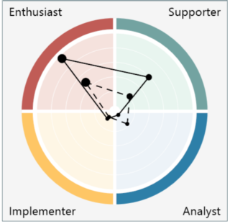
What characterizes your manager(s)?
In plenary, please discuss the strengths and pitfalls of your manager relative to the current and future core focus of the team.
Notes:
Insert the manager (or managers) and their EASI profiles with both motivation and behavior.
In plenary, discuss the manager’s/managers’ strengths and pitfalls relative to the current and future core focus of the team.
The instructor facilitates the discussion and ensures that it remains respectful and constructive.

Slide 121
topic – prevent conflicts in your team
Select and adjust the relevant slides
Delete the other slides
Delete these instructions
Notes:
We recommend not discussing this topic at team level if there are already many conflicts in the team. It is better suited to a more individual or limited number of participants than the whole team. As a going in position, you should only include people who are directly involved.
The purpose of this topic is to proactively prevent conflicts by addressing mechanisms that cause conflicts and beneficial ways to behave in the team. This is intended to minimize the risk of greater conflicts in the team.

Slide 122
Definition of a conflict
What is a conflict?
Conflicts refer to differences of opinion that involve tension between people.
Differences of opinion are about the issue at hand, whereas tensions refer to the relationship between those who disagree.
Notes:
We all experience conflicts from time to time. They can arise anywhere and anytime in a work place.
Disagreements arise occasionally, e.g. about how a task should be handled, different opinions from one’s own etc. Many people experience disagreements without necessarily having a conflict and they can usually be solved quickly. Conflicts arise when the experience involves uncomfortable feelings about another person and you feel attacked.
The source is Mads Hermansen 2004 ”Kommunikation & Samarbejde – i professionelle relationer” (Communication and cooperation – in professional relationships).
The definition of a conflict opens up to a talk about the difference between disagreements and tension.

Slide 123
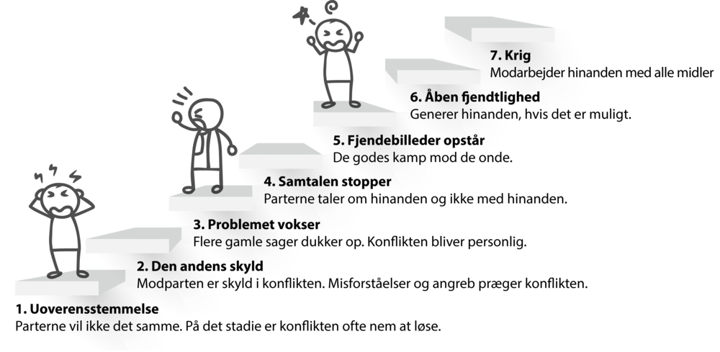
Conflict staircase
7. War
Parties obstruct each other by all means
6. Open hostility
Bother each other whenever possible
5. Enemies appear
Good versus evil
4. Dialogue ends
The parties talk about each other, rather than with each other
3. The problem escalates
Old issues pop up. The conflict becomes personal
2. Personification
The counterpart is to blame. Misunderstandings and attacks characterize the conflict
1. Disagreement
The parties want something different. At this stage the conflicts is often easy to solve
Notes:
The Conflict Staircase is a model that visualizes the destructive escalation of conflicts.
The model offers an overview of the conflict’s escalation and dynamics so that you can move down the steps when a conflict occurs and get good advice about how to tackle the conflict at different stages.
The source is Mads Hermansen 2004 ”Kommunikation & Samarbejde – i professionelle relationer” (Communication and cooperation – in professional relationships). And ARBEJDSMILJØWEB.DK (about working environment).

Slide 124
Conflict management
Person
Want to solve issues before they turn into a conflict
Choose battles selectively
Focused on communicating constructively
Expect others to listen and speak decently to each other (”I will not share my dissatisfaction if no one is listening anyway…”)
Become sensitive around conflicts
Listening and present
Consider multiple perspectives
Focused on maintaining a good atmosphere
Most often prefer face-to-face
E
Gladly tackle a conflict
Become emotional around conflicts
Talk a lot, also about him-/herself and own point of view
Quick decisions
Speedy
Animated body language
Most often face-to-face
S
Control
Gladly take on a spontaneous and direct confrontation or conflict
Expect the conflict to be over right after
Become authoritative and direct around conflicts
Time is precious. Cut to the chase and voice dissatisfaction explicitly
Expect others to speak up if they’re dissatisfied (”they’ll have to get in the game…”)
Focused on removing obstacles to reaching goals and results
Participate
Only take on conflicts if it helps the task
Will come prepared
Become very professional/factual around conflicts and keep their focus on the issue
Build on well-prepared documentation
Go into detail
Often stuck in the past
Most often prefer to communicate in writing
I
A
Task
Notes:
This model offers inspiration for the types’ different preferences relative to handling conflicts.

Slide 125
Avoid conflicts
Tak for input
Huset er ved at få sidste rettelser
Participative management
Positive atmosphere
Willingness to cooperate
Actively balanced participation
Value differences
Open handling of conflicts
Clear goals
Defined roles
Open and clear communication
Efficient decision-making processes
Source: The Pfeiffer book and Successful Teambuilding Tools.
Notes:
Prevent conflicts by having a solid foundation; 1) Clear goals for the team, 2) clearly defined roles in the team, 3) open and clear communication within the team and 4) efficient decision-making processes in the team.
Source: The Pfeiffer book and Successful Teambuilding Tools.
The above model shows the characteristics of successful teams. The model can be used to show your team and identify unclear areas that might prevent the team from functioning at its best. The boxes in the model are carefully placed: The boxes at the bottom are the foundation for the others and must be in in place during the team’s early phase.
The second row is also essential to the early phase and completely dependent on the foundation (bottom row). The third row shows characteristics that make it satisfying and beneficial to be a part of the team. According to experience, the top box – participative management – is the only one that may be moved without upsetting the others. This does not mean that management and management style is of no relevance, but that the leader is not the determining factor, especially in the early phases of the team. It can also mean that leadership may shift between members depending on the task or the team’s ”development phases”, which we’ll come back to.

Slide 126
Communication is essential
Your language can escalate or de-escalate a conflict
Conflicts can be escalated or de-escalated by the way we talk with each other.
We are different as types.
The greater your insight into the linguistic mechanisms of language, the better you become at keeping calm and finding a constructive path out of the early stages of a conflict.
Source: Styrelsen for It og Læring
Notes:
A conflict may emerge or dissolve based on the way you communicate.
A stare may irritate the person who is being stared at whereas a tender/friendly touch may show the counterpart that no ill will is intended despite the disagreement.
Language can escalate a conflict, e.g. through blame, judgement, criticism, generalizations and (mis)interpretations.
Source: Styrelsen for It og Læring (public authority for IT and learning)

Slide 127
Exercises – prevent conflicts in your team
Select and adjust the relevant slides
Delete the other slides
Delete these instructions

Slide 128
Escalating vs de-escalating language
Language that escalates a conflict:
Wanting to be right
Interrupting, raising your voice
Playing the person, not the ball: ’It’s just because you….’
Using ’you’
Focusing on others’ mistakes and shortcomings
Focusing on what has happened previously
Blaming
Attacking, judging, assessing
Lecturing, patronizing
Making demands or being defensive
Generalizing (”always” or ”never”)
Displaying unreceptive body language: Looking away, crossing your arms, pointing an accusatory finger…
Language that de-escalates a conflict:
Playing the ball; the specific action/behavior
Aiming for a solution to the conflict
Focusing on future opportunities
Trying to reach a mutual understanding
Taking responsibility
Using ”I”
Exploring the issue and the other person’s perspective
Making room for differences
Requesting or wishing
Being specific (giving examples)
Speaking calmly and listening till the other person has finished
Using accommodating body language: Looking at the other person, nodding, keeping your arms open…
Source: Styrelsen for It og Læring
Notes:
List of examples of language that may escalate or de-escalate a conflict in real life.
Go over the two columns in plenary. Split the team into small groups.
Discuss how each one of you may preventively de-escalate conflicts through your daily communication with your colleagues.
Group work: 20-30 minutes. Debrief in plenary.
Consider printing the list as a handout for the groups.
Source of this model: Styrelsen for It og Læring (public authority for IT and learning)

Slide 129
Recap and evaluation
Select and adjust the relevant slides
Delete the other slides
Delete these instructions
Notes:
Closing the presentation.
We recommend that you don’t skip this.

Slide 130
Recognizing each other
Write a note and stick it on your colleague’s back.
Answer the question: how does he/she contribute to creating a good team in your daily work.
Everyone must make a note
Notes:
An exercise that focuses on recognizing each team member anonymously.
The exercise aims to provide positive feedback in writing to everyone.
By asking them to write a note for each colleague, participants are ‘forced’ to consider what may be positive about each different colleague – including those that they don’t work closely with.
The feedback must only consist of positive words and phrases.
Participants place their notes on the backs of their colleagues so they can’t read them right away.
The notes are most often anonymous.
Participants answer the question: How does your colleague contribute to building/maintaining a good team in your daily work?
Take care that no one is overlooked. It’s the instructor’s responsibility to make sure everyone gets a note from the others.

Slide 131
recap
What are you taking away from this?
What made you curious?
What will you do differently tomorrow?
Next step…?
Notes:
A recap of the workshop that encourages participants to take action tomorrow already.
It’s important to put the team’s learning from the workshop into action as soon as possible after the workshops.
The sooner, the better.
According to Lucy Adams our brains forget their learning quickly, if it is not applied right away.
After 21 days, participants will have ”forgotten” that they went to a workshop and will need to refresh everything they learned.

Slide 132
For next time
Practice adapting your communication to the receiver.
Please bring at least 2 specific examples of situations where you consciously adapted your behavior and communication to the receiver’s type.
What exactly did you do?
What was difficult?
What worked well?
Notes:
An example of a task to be assigned before the next session.
Specific and relevant homework to sharpen the participants’ focus on applying their learning immediately after the workshop.
Often we send the team home with one or more concrete tasks that allow them to utilize their learning and thereby increase its effect on their work.
Generally, it’s important to put the team’s learning from the workshop into action as soon as possible after the workshops.
The sooner, the better.
According to Lucy Adams our brains forget their learning quickly, if it is not applied right away.
After 21 days, participants will have ”forgotten” that they went to a workshop and will need to refresh everything they learned.

Slide 133
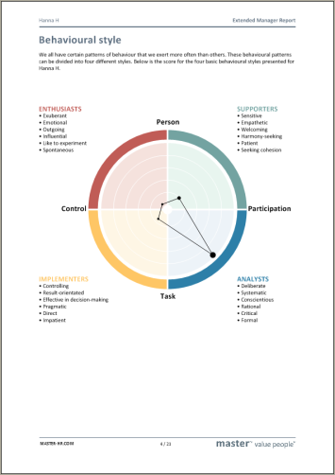
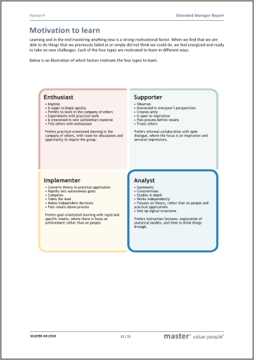
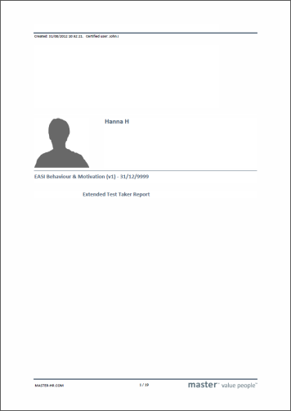
Hand out of easi reports
Notes:
As the instructor it’s your choice whether participants should download their EASI reports after they complete the questionnaire or not.
The team as a whole is the primary focus of this presentation, as opposed to each individual. We focus on how a team can be more successful.
The advantage of participants not having seen their EASI profiles in advance is that they are not as focused on their own profile, but are more open to learning about the team as a whole during the workshop.
We often hand out the participants’ EASI reports at the end of the workshop. This slide makes it easy.

Slide 134
Thank you
Notes:
Final slide with a closing ”Thank you for today”.

